Slide 1
Theory of Production

Slide 2
What is Production ?
It is the TRANSFORMATION of ??
Goods
Service
UTILITY of a good -
Tangible or Intangible
Form or STRUCTURAL utility
Place or SPATIAL utility
Time or TEMPORAL utility

Slide 3
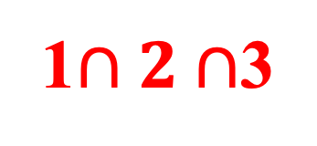
What is Production ? contd.
Form
Place
Time
1
2
3
1$∩2∩$3

Slide 4
Total Physical Product (TPP)
TPP refers to the overall physical production due to the quantity of inputs used
TPP_{n} = MPP₁ + MPP₂ + … + MPP_{n}
TPP_{n} = $\int_{1}^{n}{(MPP)(dQ)}$
Average Physical Product (APP)
APP refers to the TPP produced per unit of the inputs used
APP_{n} = $\frac{{TPP}_{n}}{Q_{n}}$
Marginal Physical Product (MPP)
MPP refers to the addition caused to TPP by using an additional unit of inputs
MPP_{n} = $\frac{d{(TPP}_{n})}{d{(Q}_{n})}$
MPP_{n} = TPP_{n} – TPP_{(n – 1 )}

Slide 5
Schedule for TPP, APP and MPP
Q_{L} | 1 | 2 | 3 | 4 | 5 | 6 | 7
TPP | 42 |  |  |  |  | 175
APP | 42 | 45
MPP | 42 |  | 30 | 36 | 19 |  | -10
Q_{L} | 1
TPP | 42
APP | 42
MPP | 42
2
45*2 = 90
45
90 – 42 = 48
3
90 + 30 =120
120/3 = 40
30
4
156
39
36
5
175
35
19
6
175
29.2
0
7
165
23.8
-10

Slide 6
Calculation of TPP & APP Given MPP
Q_{L}
1
2
3
4
5
6
7
8
9
10
TPP
50
50 + 60 = 110
110 + 70 = 180
180 + 80 = 260
260 + 60 = 320
320 + 40 = 360
360 + 00 = 360
360 + (- 10) = 350
350 + (- 20) = 330
330 + (- 30) = 300
APP
50/1 = 50
110/2 = 55
180/3 = 60
260/4 = 65
320/5 = 64
360/6 = 60
360/7 = 51
350/8 = 44
330/9 = 37
300/10 = 30
MPP
50
60
70
80
60
40
0
-10
-20
-30

Slide 7
Calculation of MPP Given TPP
Q_{L} | TPP | APP | MPP
1 | 50 | 50
2 | 110 | 55
3 | 180 | 60
4 | 260 | 65
5 | 320 | 64
6 | 360 | 60
7 | 360 | 52
8 | 350 | 44
9 | 330 | 37
10 | 300 | 30
50
110 – 50 = 60
180 - 110 = 70
260 – 180 = 80
320 – 260 = 60
360 – 320 = 40
360 – 360 = 0
350 – 360 = -10
330 - 350 = -20
300 – 330 = -30

Slide 8
Schedule for TPP, APP and MPP
Q_{L} | TPP | APP | MPP
1 | 50 | 50 | 50
2 | 110 | 55 | 60
3 | 180 | 60 | 70
4 | 260 | 65 | 80
5 | 320 | 64 | 60
6 | 360 | 60 | 40
7 | 360 | 51 | 0
8 | 350 | 44 | -10
9 | 330 | 37 | -20
10 | 300 | 30 | -30

Slide 9
The Law of Variable Proportions
Stage 1
Stage 2
Stage 3
TPP
Q_{L} | TPP | APP | MPP
1 | 50 | 50 | 50
2 | 110 | 55 | 60
3 | 180 | 60 | 70
4 | 260 | 65 | 80
MPP
TPP
Fixed Factor Exhibits
Mechanical ‘FRESHNESS’
TPP
Fixed Factor Exhibits
Mechanical ‘FATIGUE’
Fixed Factor Exhibits
Mechanical
‘EXHAUSTION’
5 | 320 | 64 | 60
6 | 360 | 60 | 40
7 | 360 | 51 | 0
TPP
8 | 350 | 44 | -10
9 | 330 | 37 | -20
10 | 300 | 30 | -30
MPP
MPP
MPP
QL

Slide 10
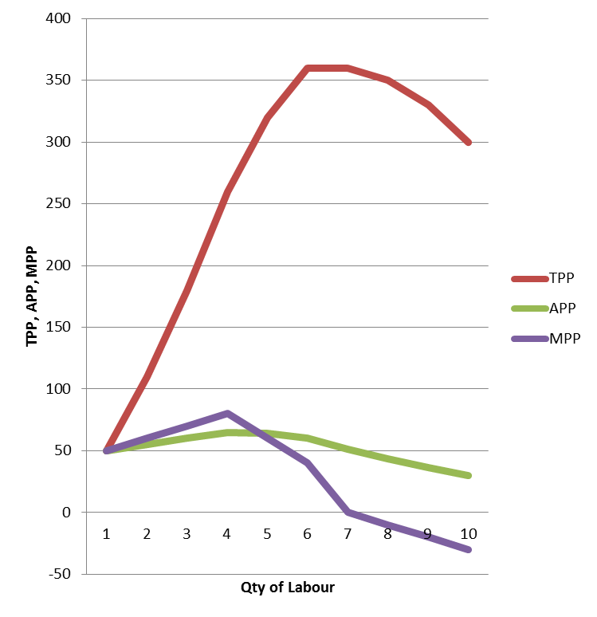
The Law of Variable Proportions
Q_{L} | TPP | APP | MPP
1 | 50 | 50 | 50
2 | 110 | 55 | 60
3 | 180 | 60 | 70
4 | 260 | 65 | 80
5 | 320 | 64 | 60
6 | 360 | 60 | 40
7 | 360 | 51 | 0
8 | 350 | 44 | -10
9 | 330 | 37 | -20
10 | 300 | 30 | -30

Slide 11
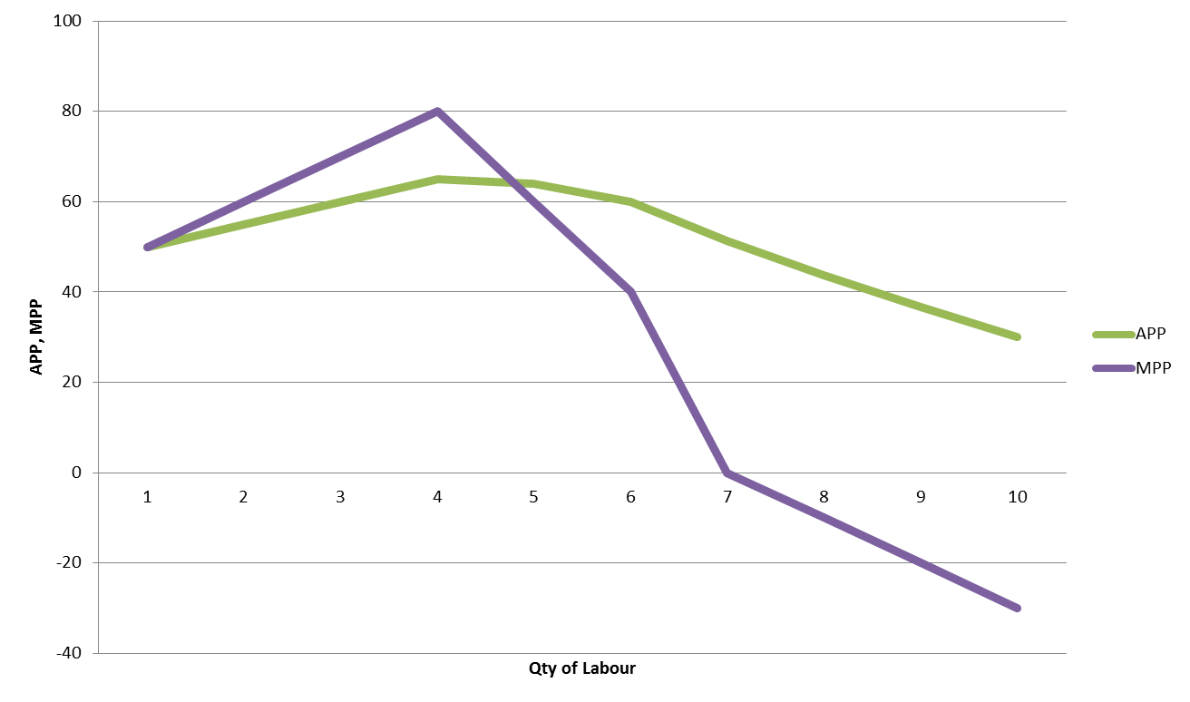
APP and MPP Curves The Law of Variable Proportions

Slide 12
Isoquants Analysis
An Isoquant is the locus of the various configurations of the factors of production involved that show the same level of output
Cap
B
IQ₃ ; 30
A
IQ₂ ; 20
IQ₁ ; 10
Lab
Isoquant Map refers to the WILLINGNESS of the producer to produce a certain quantity of output

Slide 13
Isoquants Analysis (contd.)
Let firm’s budget be Rs 5000
Let P_{L} = Rs 50/unit and P_{K} = Rs 200/unit
If entire budget is spent only on Labour, the Labour-Capital coordinates would be: C₁ = (100 L, zero K)
Cap
If entire budget is spent only on Labour, the Labour-Capital coordinates would F₁ = (zero L, 25 K)
Then F₁C₁ is the Factor-Cost line
F₃
If budget increases but P_{L} & P_{K} do not change, the Factor-Cost line shifts parallelly upwards from F₁C₁ to F₃C₃
F₂
If budget decreases but P_{L} & P_{K} do not change, the Factor-Cost line shifts parallelly downwards (F₃C₃ to F₂C₂)
F₁
C₁
C₂
C₃
Lab
Factor Cost Line
refers to the FINANCIAL ABILITY of the
producer to produce a certain quantity of the output

Slide 14
Isoquants Analysis (contd.)
Non-Parallel shifting of the Factor-Cost Line
Fig 1
Cap
Fig 2
Cap
75
50
50
200
Lab
200
300
Lab
Fig 3
Cap
Fig 4
Cap
75
50
50
40
150
200
Lab
200
300
Lab

Slide 15
Isoquants Analysis (contd.)
Producer’s Equilibrium
Points A and B are IRRATIONAL as with the same cost as E less is produced
Cap
Point E is RATIONAL as the producer’s ability and willingness are compatible
Point G is ASPIRATIONAL as the producer has the willingness but lacks the ability produce the said quantity
F
G
A
E
IQ₃
IQ₂
B
IQ₁
C
Lab

Slide 16
Isoquants Analysis (contd.)
Expansionary Path is the locus of the trajectory of production that a firm adopts, given:
Cap
Expansionary Path
F₃
The firm’s willingness and ability to produce the said quantity
IQ₃, 30
F₂
IQ₂, 20
as well as
E₃
The availability, accessibility and affordability of the contemporary state of technology
IQ₁,10
F₁
E₂
E₁
C₁
C₂
C₃
Lab

Slide 17
Isoquants Analysis (contd.)
Fig A
Fig B
Cap
Cap
Capital-Intensive
Technology
F₃
Labour-Intensive
Technology
Expansionary
Path
F₃
F₂
F₂
IQ₃, 30
E₃
Expansionary
Path
IQ₂, 20
E₂
F₁
IQ₃, 30
F₁
E₃
IQ₁,10
E₁
IQ₂, 20
E₂
E₁
IQ₁,10
C₁
C₂
C₃
Lab
C₁
C₂
C₃
Lab

Slide 18
























Laws of Returns to Scale
INCREASING R.S.
DECREASING R.S.
Cap
Cap
DECREASING R.S.
INCREASING R.S.
K₅
E₅
$$∆K_{4}$$
$$∆K_{4}$$
K₅
K₄
E₅
K₄
E₄
$$∆K_{3}$$
K₃
E₄
E₃
$$∆K_{3}$$
$$∆K_{2}$$
K₃
K₂
E₂
E₃
$$∆K_{2}$$
$$∆K_{1}$$
K₂
K₁
$$∆K_{1}$$
K₁
E₂
E₁
E₁
L₁
L₂
L₃
L₄
L₅
Lab
L₁
L₂
L₃
L₄
L₅
Lab
$$∆L_{1}$$
$$∆L_{2}$$
$$∆L_{3}$$
$$∆L4$$
$$∆L_{1}$$
$$∆L_{2}$$
$$∆L_{3}$$
$$∆L4$$
Cap
K₅
E₅
$$∆K_{4}$$
K₄
E₄
$$∆K_{3}$$
K₃
CONSTANT Returns to Scale
$$∆K_{2}$$
E₃
K₂
E₂
$$∆K_{1}$$
K₁
E₁
L₁
L₂
L₃
L₄
L₅
Lab
$$∆L_{1}$$
$$∆L_{2}$$
$$∆L_{3}$$
$$∆L4$$

Slide 19
Law of Increasing Returns to Scale
Cap
F₅
F₄
F₃
F₂
K₅
E₅
K₄
$$∆K_{4}$$
E₄
F₁
E₃
IQ_{3,} 50
K₃
$$∆K_{3}$$
IQ_{3,} 40
K₂
$$∆K_{2}$$
E₂
IQ_{3,} 30
$$∆K_{1}$$
E₁
IQ_{2,} 20
K₁
IQ_{1,} 10
$$∆L_{1}$$
C₁
$$∆L_{3}$$
$$∆L_{4}$$
C₂
C₃
C₄
C₅
L₁
L₂
$$∆L_{2}$$
L₃
L₄
L₅
Lab

Slide 20
Law of Decreasing Returns to Scale
Cap
F₅
F₄
F₃
K₅
E₅
$$∆K_{4}$$
F₂
IQ_{5,} 50
K₄
E₄
$$∆K_{3}$$
F₁
IQ_{4,} 40
K₃
E₃
$$∆K_{2}$$
E₂
IQ_{3,} 30
K₂
E₁
$$∆K_{1}$$
K₁
IQ_{2,} 20
IQ_{1,} 10
C₁
C₂
C₃
C₄
C₅
L₁
$$∆L_{1}$$
L₂
$$∆L_{2}$$
L₃
$$∆L_{3}$$
L₄
$$∆L_{4}$$
L₅
Lab

Slide 21
Law of Constant Returns to Scale
F₅
Cap
F₄
F₃
K₅
F₂
E₅
$$∆K_{4}$$
E₄
IQ_{3,} 50
K₄
K₃
$$∆K_{3}$$
E₃
IQ_{3,} 40
F₁
$$∆K_{2}$$
E₂
IQ_{3,} 30
K₂
$$∆K_{1}$$
E₁
IQ_{2,} 20
K₁
IQ_{1,} 10
$$∆L_{1}$$
C₁
$$∆L_{3}$$
C₂
$$∆L_{4}$$
C₃
C₄
C₅
L₁
$$∆L_{2}$$
L₃
Lab
L₂
L₄
L₅

Slide 22
Laws of Returns to Scale
Cap
IRS to DRS ???
DRS to IRS ???
Lab

Slide 23
Laws of Returns to Scale (Contd.)
1st Mover Advantages
Loss of 1st Mover Advantages
Product backfires
a.
1. Lack of rivalry
Increased rivalry
b.
2. Sole access to resources
c.
Resource scarcity sets in
3.
Novelty value = control on SS
d.
Increasing input cost
4. IPR protection = control on SS
e.
Price rises and demand falls
5.
f.
Customer acquisition & retention
Profitability reduces
g.
6.
Tech obsolescence sets
Brand recognition
Govt reduces patronages
7.
h.
Price setting (inputs & outputs)
Opportunity cost
i.
8.
High govt. patronage
j.
Increased selling costs
Better financial access
9.
k.
Threat of Subs / versions

Slide 24
Laws of Returns to Scale
Cap
E₉
E₈
E₇
IRS to DRS ???
E₆
E₅
DRS to IRS ???
E₄
E₃
E₂
E₁
Lab

Slide 25
Laws of Returns to Scale (Contd.)
Segment 4
Cap
Segment 3
Segment 2
Segment 1
Lab

Slide 26
Laws of Returns to Scale (Contd.)
Cap
Segment 4
Segment 3
Joseph Alois Schumpeter (1883 -1950; Harvard University)
Innovation = Creative Destruction
Segment 2
New products, new versions of the old product
New methods of production
New raw materials and new sources of raw material
New markets
New methods of business / financing
Segment 1
Lab

Slide 27
Laws of Returns to Scale (Contd.)
Cap
Cap
E₉
E₈
Lab
E₇
E₆
This could represent
Any of the segments
E₄
E₅
E₃
E₂
E₁
Lab

